Slide 1
EDA Mini Project.
By – Smruthi Bhandiwad

Slide 2
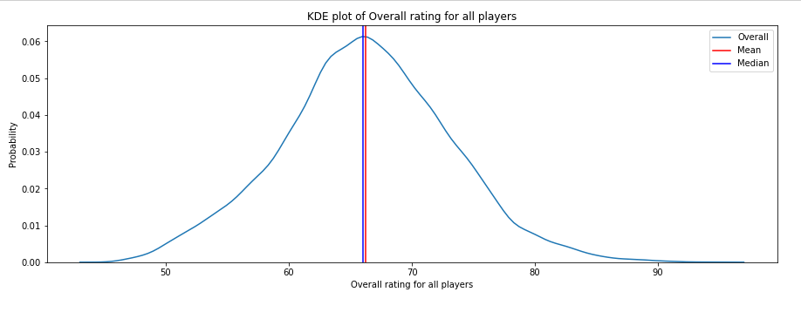
Distribution of overall rating of players.
By Plotting the graph is normally distributed For Overall Rating of the Players we can notice that :
The Skewness for this were also 0.
There is Mean & Median Values were Closer to each other.

Slide 3
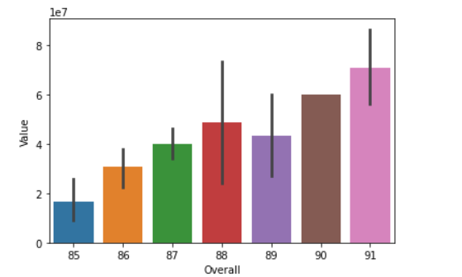
Analysis Of top 20 players Ranked by Overall score and whose contract expires in 2020
Age Of the Top 20 players lies between 27 yr to 35 yr & Wages Between $38000 to $420000.
As we can see Average Age of Top 20 Players is 31 years & with Average Wages were 20,5450.
As the “Overall Rating” of the player Increases the
“Value” of the Player Also Increases, there is
Correlation between Overall Rating & Value.

Slide 4
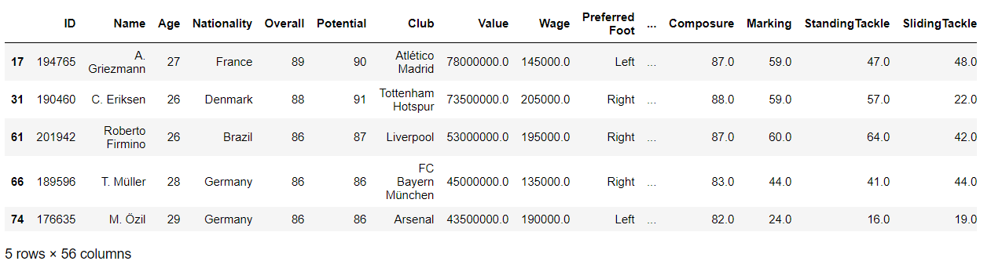
Analysis Of top 5 players by Overall rating for each unique position
The Top 5 Players by Overall Rating for each Unique Position

Slide 5
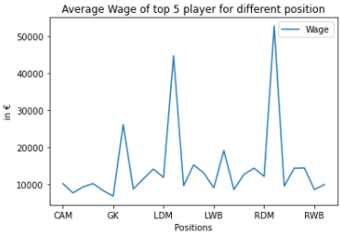
As per the Position the Average wage of the Top 5 Players Changes

Slide 6
Conclusion :
Analysis of FIFA Dataset the “Brussels United FC” which was newly formed there management body members can select there 20 Player by looking on above Top 20 Players Data Analysis.
As They can select top 5 player from 20 Players by looking on Top 5 Player Data Analysis.
For Hiring of Players in limited Budget, So as per the Unique Position & Wages the management board members can take decision easily.

